Slide 1
How to share an existing record in the Member Institution with the Network Zone institution
Including using a match profile
Yoel Kortick
Senior Librarian

Slide 2
Agenda
Introduction
The match profiles defined in the Network Zone
The sample existing record in the Network Zone
The sample existing record in the Member Institution
Sharing the existing record in the Member Institution with the Network Zone
2

Slide 3
Introduction

Slide 4
Introduction
In this presentation we will
    Share an existing record in the Member Institution with the Network Zone institution when the same record already exists in the Network institution

Slide 5
Introduction
In the example here we have a Network Zone and three Member Institutions:
Member / Network | Name | Inst. Code
Network | Ex Libris University Consortium | EXLDEMO2_INST
Member | Alma University | EXLDEV1_INST
Member | Open University | EXLDEMO3_INST
Member | University of Knowledge | EXLDEMO1_INST

Slide 6

Introduction
Network Zone
Ex Libris University Consortium
Member Institution
Alma University
Member Institution
Open University
Member Institution
University of Knowledge

Slide 7
The match profiles defined in the Network Zone

Slide 8
The match profiles defined in the Network Zone
In our example the following two match methods will be used when a staff user does “Share with network” from the Member Institution and Alma “looks for” a match in the Network Zone institution.
In the Network Zone we have defined as follows at "Configuration > Resources > General > Other Settings"
  non_serial_match_method = the ISBN Match Method
  serial_match_method = the ISSN Match Method
For descriptions of these match methods see: Match Methods – Explanations and Examples
For descriptions of what should be put in “Other Settings” for each match method see: Configuring Other Settings

Slide 9
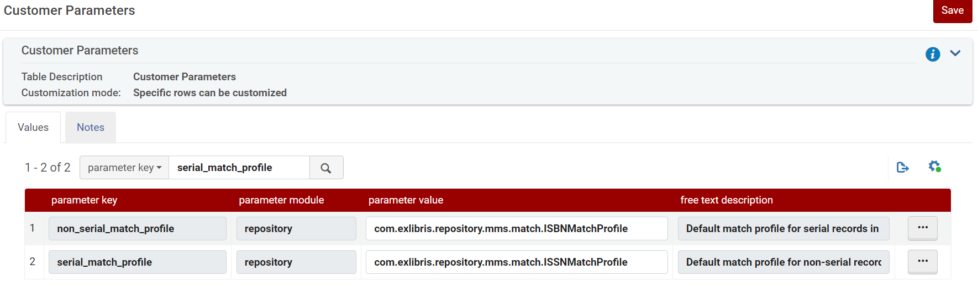
The match profiles defined in the Network Zone
In the Network Zone
This uses ISBN Match Method
This uses ISSN Match Method

Slide 10
The match profiles defined in the Network Zone
Note that just so we can “prove” that the match method is coming from the Network Zone and not the Member Institution we have the following in Member Institution Open University.
  non_serial_match_method = 035 (Other System Identifier) Match Method
  serial_match_method = the 035 (Other System Identifier) Match Method
This match method uses 035 and no other fields. Our records will not have 035 fields, yet a match will be made, therefore we know the match profile is coming from the definition in the Network Zone (which uses ISBN and ISSN to match).

Slide 11
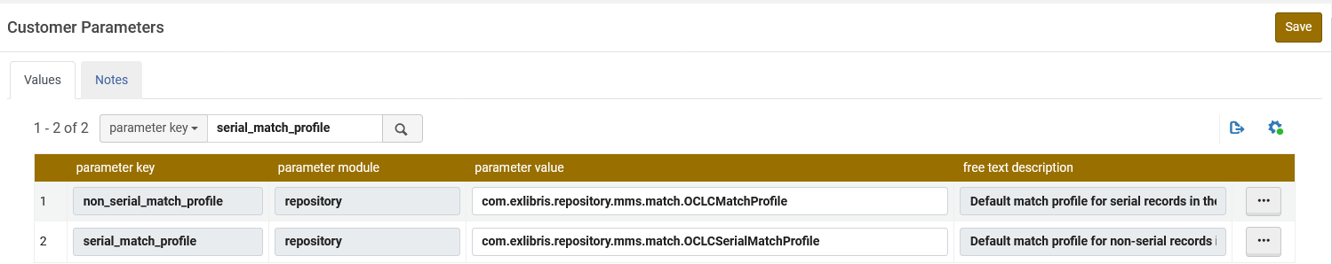
The match profiles defined in the Network Zone
Here is what we have at Member Institution Open University
This uses 035 (Other System Identifier) Match Method
This uses 035 (Other System Identifier) Match Method

Slide 12
The sample existing record in the Network Zone

Slide 13
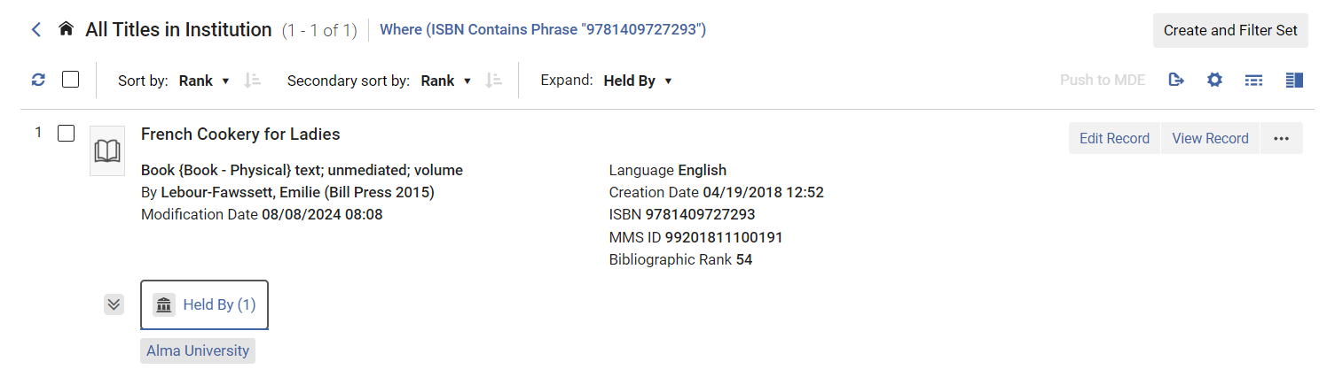
The sample existing record in the Network Zone
In the Network Zone we have title "French Cookery for Ladies" ISBN 9781409727293
We see that it is "Held By" one Member Institution which is Alma University.
"Held By" one Member Institution: “Alma University of Knowledge"
Note (for later) that Network Zone MMSIDs end (in our case) with 0191

Slide 14
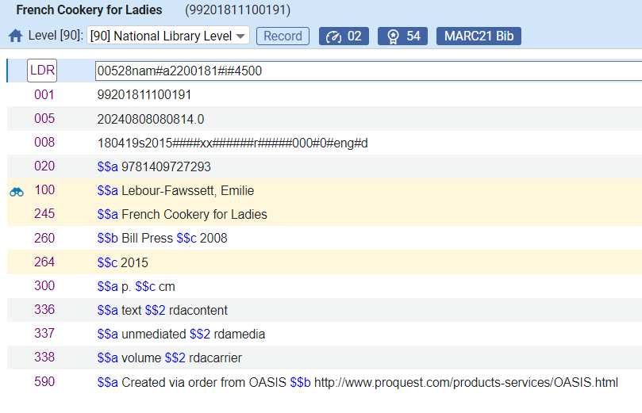
The sample existing record in the Network Zone
The record in the Network Zone (title "French Cookery for Ladies" ISBN 9781409727293) does not have a 035 thus no match could be made on the 035

Slide 15
The sample existing record in the Member Institution

Slide 16
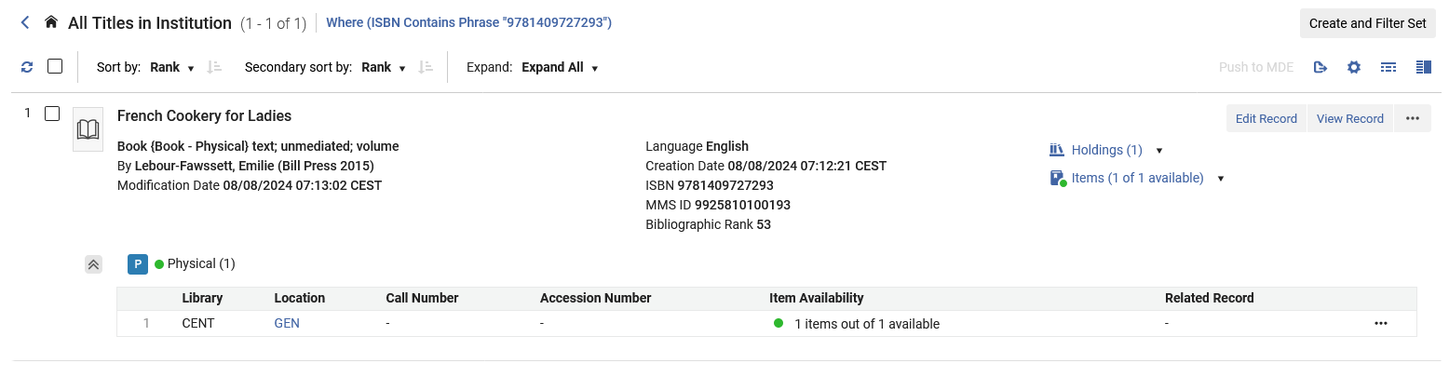
The sample existing record in the Member Institution
In Member Institution Open University, we also have title "French Cookery for Ladies" ISBN 9781409727293. It is not linked to the Network Zone.
Not linked to Network Zone. There is no icon stating that it is linked to the network Zone
Note (for later) that Member Institution Open University MMSIDs end with 0193

Slide 17
Sharing the existing record in the Member Institution with the Network Zone

Slide 18
Sharing the existing record in the Member Institution with the Network Zone
We will now share this record with the Network Zone and see it link to the existing record in the Network Zone.
In Member Institution Open University, we edit the existing record

Slide 19
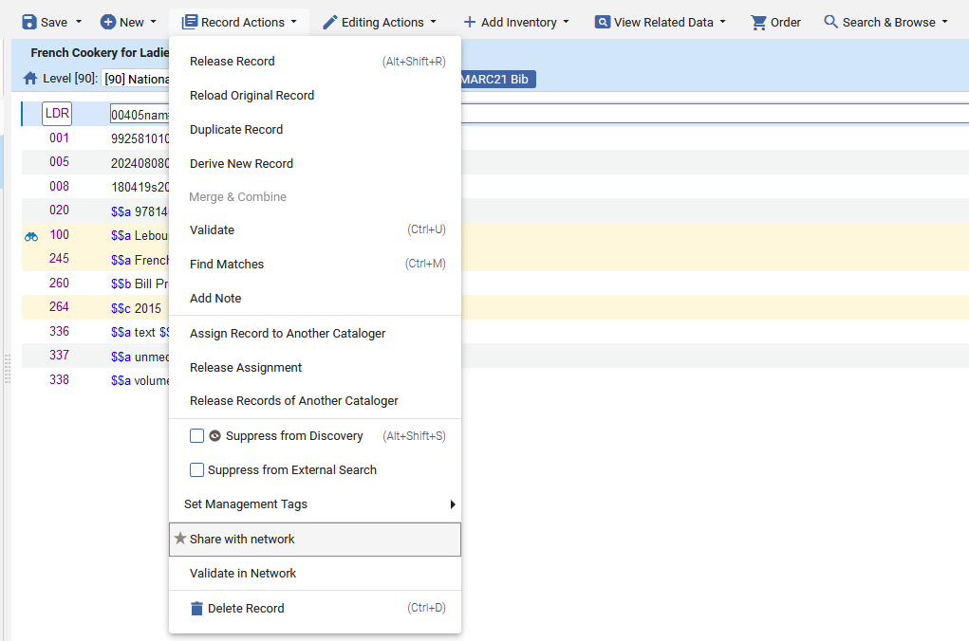
Sharing the existing record in the Member Institution with the Network Zone
Under “Record Actions” we will choose “Share with Network”

Slide 20
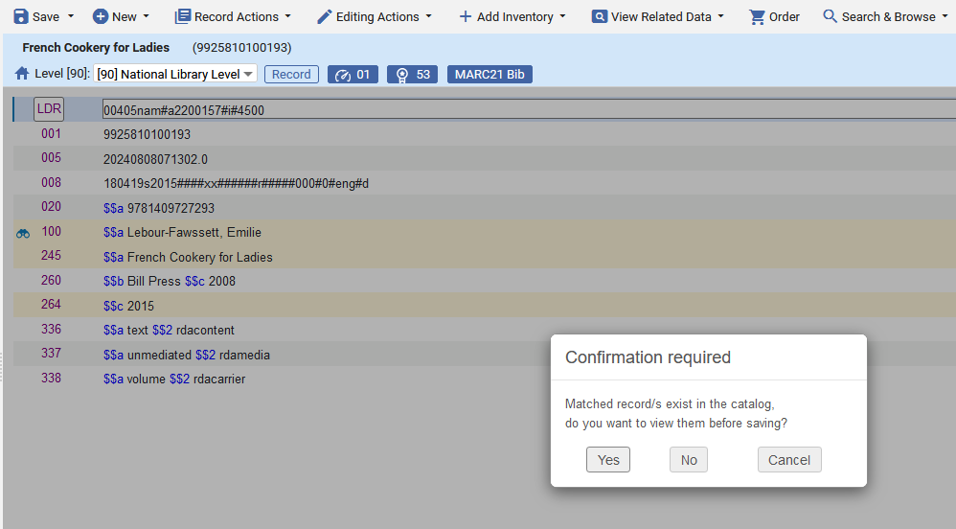
Sharing the existing record in the Member Institution with the Network Zone
We are notified that matching records exist in the network, and we will choose to view them

Slide 21
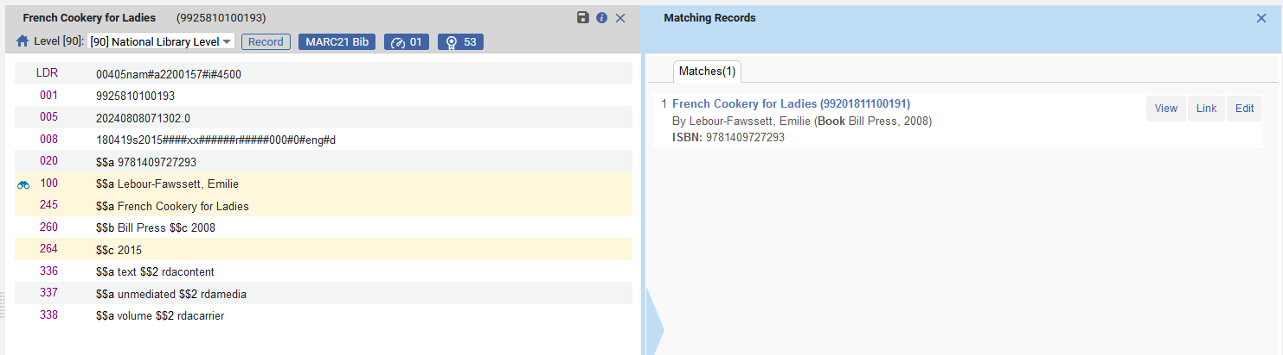
Sharing the existing record in the Member Institution with the Network Zone
We can now either link to the matched record or view it first. We will view it first.
Could already link from here but we will instead first view
We know it is matching a Network Zone record because the MMSID ends in 0191.
Alma found a matching record in the network Zone based on the ISBN because of the non_serial_match_method

Slide 22
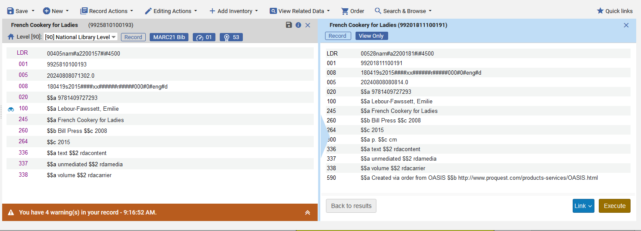
Sharing the existing record in the Member Institution with the Network Zone
We can now either link to the matched record here or go “back to results” and link from the previous page. We will create the link from here.
We know it is matching s Network Zone record. The MMSID ends in 0191.
We know it is matching s Network Zone record. The MMSID ends in 0191.
Link to the Network Zone record

Slide 23
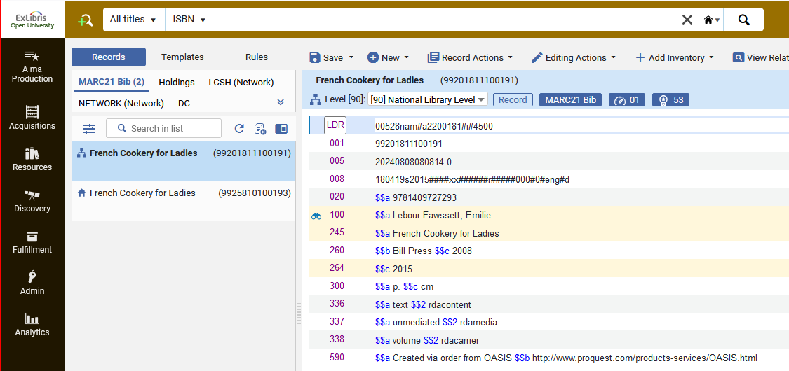
Sharing the existing record in the Member Institution with the Network Zone
The record is now linked to the Network Zone
Record is linked to Network Zone
In Member Institution
This is the “old non linked” record which will disappear from the Metadata Editor next time it is refreshed or reopened

Slide 24
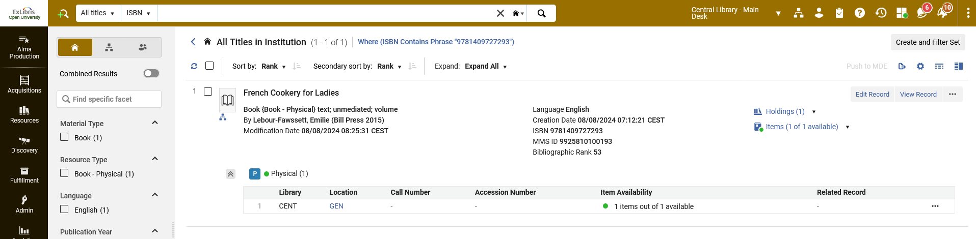
Sharing the existing record in the Member Institution with the Network Zone
Now, because the record is linked to the Network Zone, when searching Member Institution Open University, we have one record, and it is linked to the Network Zone
In Member Institution
Record is linked to Network Zone
In scope of Member Institution

Slide 25
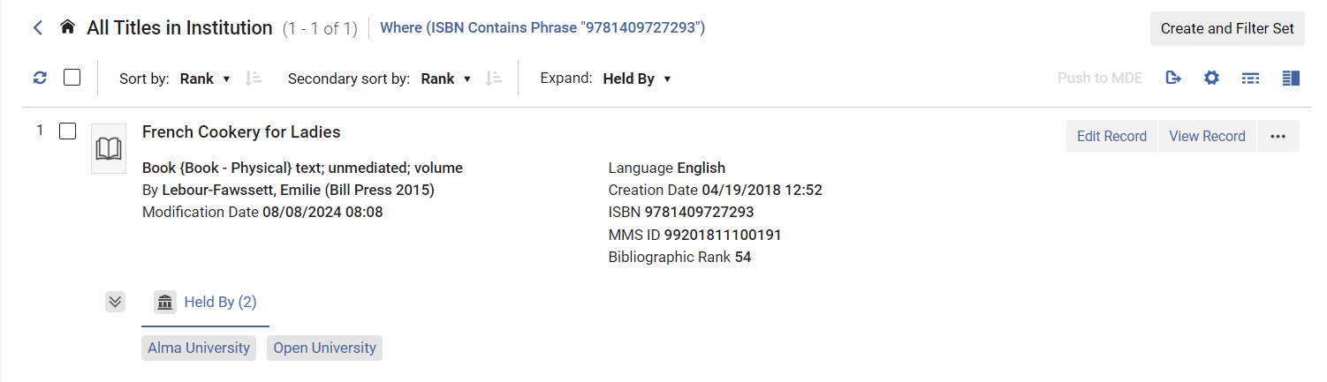
Sharing the existing record in the Member Institution with the Network Zone
Now when searching the Network Zone institution, we see that the record is held By both Alma University and Open University.
Previously it was held by only Alma University.

Slide 26
Thank You

